Slide 1
Data Measure
Part 2: median and Mean
Ms.Latham

Slide 2
Review from previous lesson
Discuss with your partner which words match the definitions.
  A. Maximum
  B. Minimum
  C. Range
  D. Mode
1. Smallest number in the dataset
2. Most frequent number in the dataset
3. the distance between the minimum and maximum
4. largest number in the dataset

Slide 3
Review from previous lesson
Discuss with your partner which words match the definitions.
  A. Maximum
  B. Minimum
  C. Range
  D. Mode
1. Smallest number in the dataset
2. Most frequent number in the dataset
3. the distance between the minimum and maximum
4. largest number in the dataset
Practice: 3, 4, 4, 5, 7, 8, 8, 8, 10

Slide 4
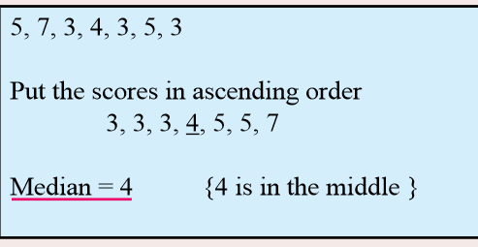
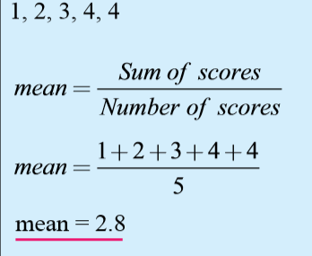
24
7
30
Date
Data Measure – Median and Mean
EQ – What does median and mean tell us about a dataset?
What is the median?
The middle number when the data is in order
What is the mean?
(also called the average)
The mean describes the middle of all the numbers.
First you add all of the numbers together and then divide by how many numbers there are.
Notes:
Ask student to write questions for the notes.
Model Chunking of notes.

Slide 5
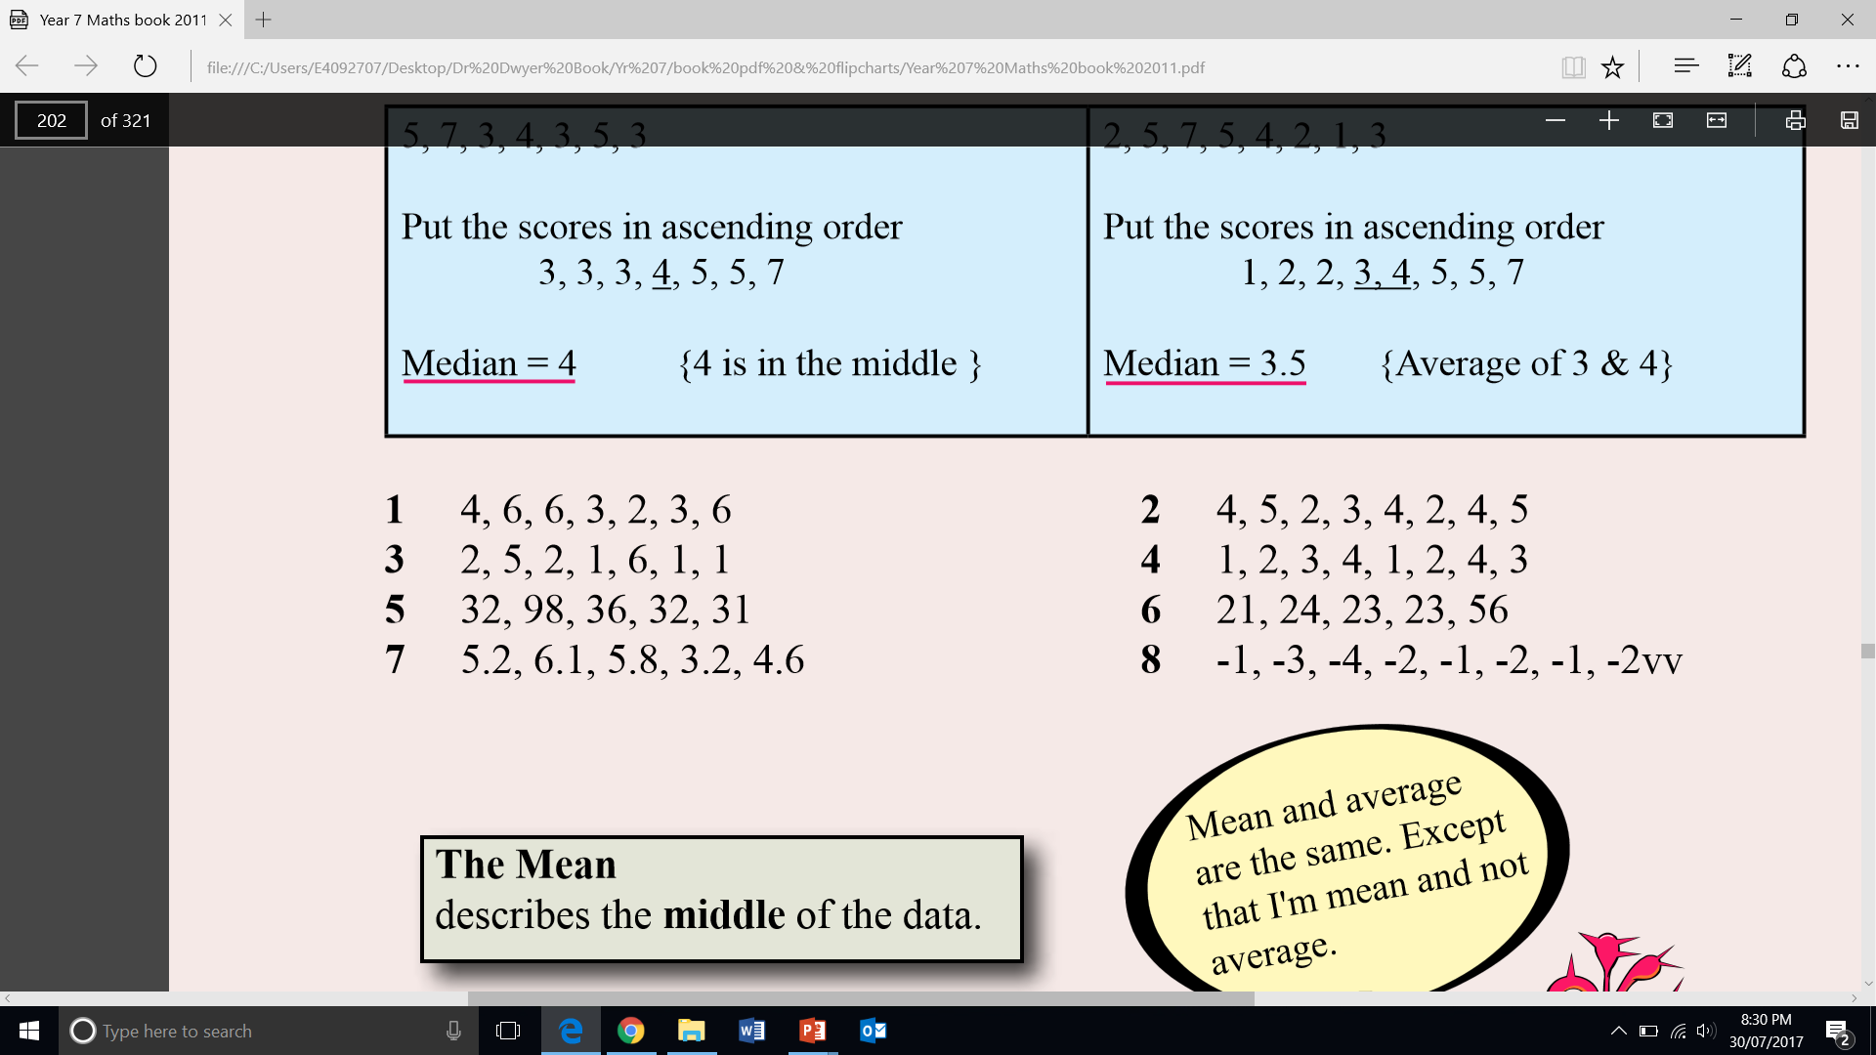
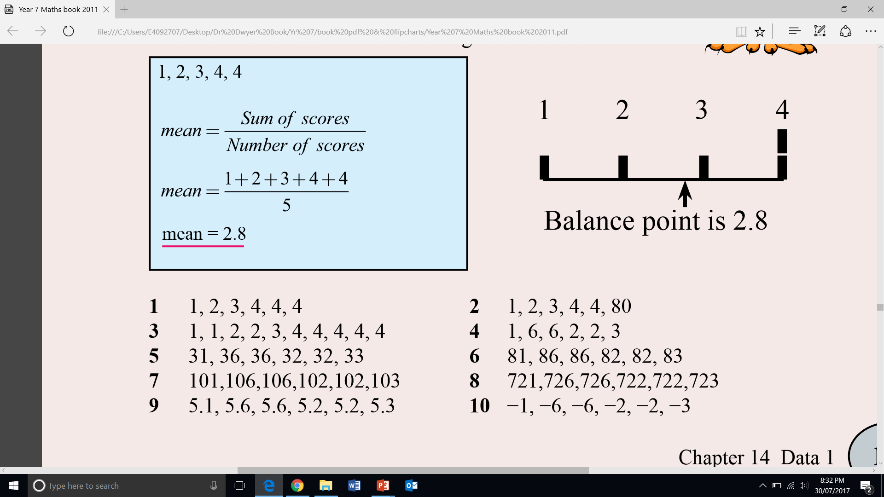
Guided Practice
Find the median:
Find the mean:

Slide 6
Independent practice
Find the median:
Find the mean:

Slide 7
Practice in pairs
In pairs you will race to calculate the data measures (mean, median, mode, range, min, and max) from a set of cards.
You will compete against the pair nearest you and keep track of the points.

